Slide 1
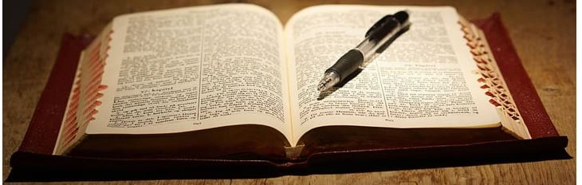
A Call to the Ministry: Pastoral Epistles Block Class with Pastor Bud Talbert
Do you feel called to the ministry? What is a biblical philosophy of ministry? This class is a brief exposition of 1 & 2 Timothy and Titus with an emphasis on the call to vocational preaching and a biblical philosophy of local church ministry.

